Slide 1

Evolutionary Algorithms

Slide 2
Evolutionary Algorithms
The systems we see today show tremendous performance, in part because they have adapted to and evolved from the changing environment over time.
Evolution is a predominant phenomenon in most natural systems. In artificial systems, evolution is attributed to the study of the success of this phenomenon in its natural counterparts.
We see that these systems keep getting better over time as a result of continuous adjustment, adaptation, and learning.
The systems now model a problem in such a way that the solution evolves over time. This makes possible the generation of various kinds of solutions, which keep improving with time. The artificial systems being built are better adaptive to the changing environment.

Slide 3
Evolutionary Algorithms
Optimization has always been one of the major problems in the field of computation. In these computations, we must optimize the solutions to any problem. If the number of possible solutions were been constant, it would make sense to find all the possible solutions and then compare their performances.
Optimization problems always have multiple solutions with varying degree of goodness or accuracies. The best solution is the one that has the most optimal (maximum or minimum) value of the objective function.
Optimization problems are also studied as search problems. The goal is to search for the best possible combination of values of the parameters that gives the most optimal objective value of the objective function.

Slide 4
Evolutionary Algorithms
Evolutionary computation has many applications in the optimization problems, which keep generating solutions with each newer generation obtaining solutions better than those obtained by the previous generation.
Some of these applications include robotics, functional optimizations, and character and other recognition systems, to name a few.

Slide 5
Biological Inspiration
Evolutionary computation, or evolutionary algorithms (EAs), is an inspiration derived from its biological counterparts.
The strong correlation between the artificial and the natural evolution systems has resulted in many terminologies of the artificial systems being borrowed from the natural evolution system.
The Genetic Algorithms(GA) is inspired from the survival and reproductive systems of the natural species.
Charles Darwin’s theory of “Survival of the fittest.”
Only the traits of the fittest individuals pass from one generation to the next, while the traits of the others die out.
Another concept in the natural systems is that of fitness, or the ability of the individual to survive in the entire population. A high-fitness individual means a high chance of survival. Fitness is also a measure of the individual’s reproductive power, or fertility.

Slide 6
Genetic Algorithms
We will discuss about the traditional GA, commonly known as the simple genetic algorithm (SGA). The GA is an effective way to solve real-life problems based on evolutionary ideas. It is the most commonly used technique of evolutionary algorithms.
Concept
The GA starts with a set of solutions or populations. Each individual in the population set represents a solution to the problem. The nature of the solution, however, varies. Some solutions may be very good, while others are very bad.
To measure the goodness of the solution, we use a function called the fitness function, which must be made according to the program logic.
Initially the population set contains all randomly generated solutions that are initially generated. This is called the first generation of the population.

Slide 7
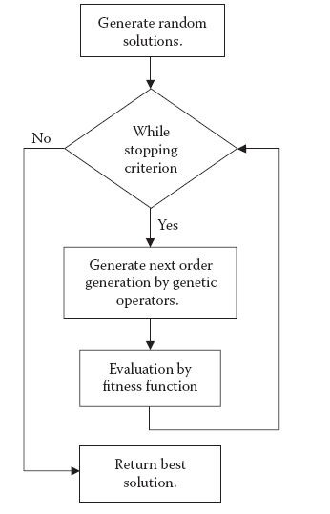
Genetic Algorithms
Various other genetic operators are also applied that help generate the new population set.

Slide 8
Genetic Algorithms
In this manner, we generate higher-order generations from the lower order. The fitness of any solution or individual may be measured by the fitness function. A higher value of the fitness function means better solutions.
The fitness of the population is measured by the average fitness of all the individuals that make up the population. It is observed that the fitness keeps increasing as we move forward with the algorithm. The higher-order generations are more fit when compared with the lower-order generations.
The basic algorithm follows an iterative approach and continues to generate newer generations. For the most part, the solution keeps improving with time until it finally converges or the improvement in the solution is unnoticeable. There must be a stopping criterion at which the loop terminates.

Slide 9
Genetic Algorithms
Solution
The GA is applied to the optimization problems, in which we are required to optimize an objective function by varying some variables or parameters.
Solution is an individual in the population set that represents a set of parameters or variables of the problem to be optimized. The solution may be good or bad, depending on the fitness measured by the fitness function.
Consider the problem of functional optimization, in which we are given a set of input variables. We have an objective function that we must optimize, which is the goal of the problem.
In this problem, a solution may be represented by two values, one corresponding to the value of a and the other corresponding to the value of b. The general form of any solution may be taken as (a, b).

Slide 10
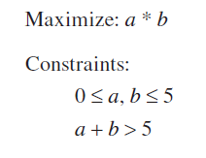
Genetic Algorithms
The solution may be feasible or infeasible. Infeasible solutions usually disobey some constraint of the problem and are hence not valid solutions. Infeasible solutions cannot be returned as the final solutions by the GA and are usually not accepted in the solutions at all.
We rather repair them to make them feasible and then allow them to enter the population set. Another possibility for dealing with infeasible solutions is to assign them a very low fitness value.
According to the theory of survival of the fittest, it may be assumed that they would then die out with the passage of time. In the above problem, the solution (2, 10) is infeasible because it does not obey the constraint 0 ≤ a, b ≤ 5.

Slide 11
Genetic Algorithms
We have represented the solution in an easy-to-understand format phenotype solution format. The GA, however, may require a different representation of the solution, in this case the genotype solution, to perform and function.
The genotype solution is usually a sequence of bits. Each bit may be either 0 or 1. The whole phenotype solution is represented in such a way that we may represent it in the form of continuous bits.
The conversion of the solution into this format of bit string comes from the classic theory of GA. The various fenetic operators were designed assuming the individuals were a series of bits.
To represent a, we require a minimum of three bits (23= 8 ≤ 6). Similarly to represent b, we require at least three bits. The entire solution may hence be represented as a sequence of six bits.

Slide 12
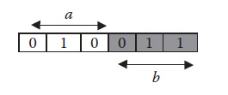
Genetic Algorithms
In general, for any problem that we need to optimize with the help of GA, we first must represent it in the form of a solution. Once this has been done, we can apply the various genetic operators to optimize and find the most optimal solution.
The use of the other GA operators is quite a trivial task.Hence one of the major design and implementation issues is a good solution design that deals with the manner in which we convert the solution to a sequence of bits or numbers

Slide 13
Genetic Algorithms
Initial Population
One of the first steps in the algorithm is to generate an initial population, or the starting population that ultimately leads to the generation of newer and newer generations. Mostly the initial population is generated randomly.
The standard practice is to generate random series of 0’s and 1’s to fill this solution. This generates highly random solutions.
The initial solution does not play a very vital role in the GA’s solution generation, as long as the initial population contains individuals of all kinds. Each bit, in some way, represents or contributes to characteristics of the solution.
Good characteristics would make the fitness value of the solution high, and vice versa.

Slide 14
Genetic Algorithms
Genetic Operators
The conversion of one generation to the next is done by means of genetic operators. The conversion is guided by the natural system.
Selection : The first operator applied is selection. Here we select the pairs of individuals that will reproduce to generate newer populations. Selection forms pairs of individuals that will later cross-breed to generate individuals.
It decides the parents that are responsible for the individuals being generated. Thus a number of strategies for the selection process have been developed.

Slide 15
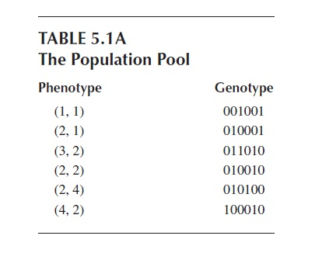
Genetic Algorithms
Selection is shown in Tables 5.1a and 5.1b, in which a random selection has been applied.

Slide 16
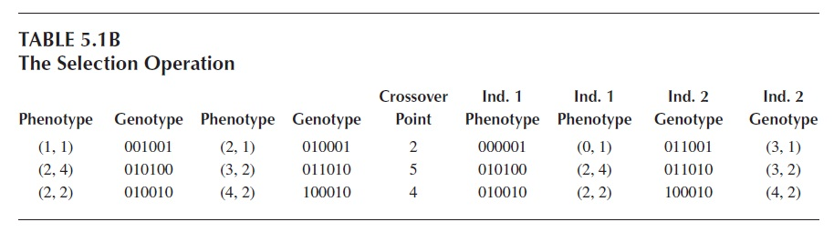
Genetic Algorithms

Slide 17
Genetic Algorithms
Crossover:
The next operation they need to perform is crossover, or the genetic operator that results in the mixing of two parents to generate individuals of the new population.
Crossover is done by taking some bits from the first parent and other bits from the other parent. One of the commonly used crossovers is the single-point crossover, in which we randomly select a point in the chromosome.
The bits to the left of this point are taken from the first parent and the bits to the right are taken from the other parent. This generates new individuals in the new population.
It is hoped that the new individuals generated from the crossover will take the better characteristics from the parents and leave out the bad ones.

Slide 18
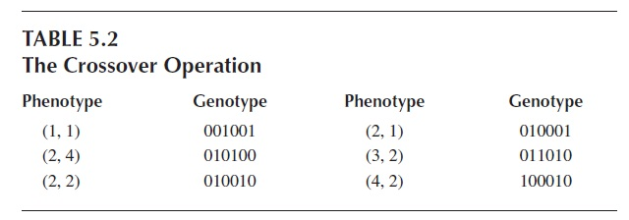
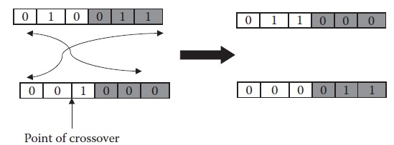
Genetic Algorithms

Slide 19
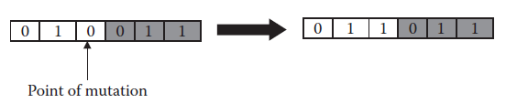
Genetic Algorithms
Other genetic operators:
There are various other genetic operators that are used for various specialized purposes. Each aids in the generation of a good population set. Each genetic operator, in its own way, contributes to optimization by adding the possibility of the generation of good solutions.
The mutation genetic operator.

Slide 20
Genetic Algorithms
Fitness Function
The quality of the solution or of any individual is measured by the fitness function. This function decides how good the solution is.
In general, a good solution will have a high value of fitness function, whereas a bad solution will have a low value.
The fitness function gives a quantifiable way for us to measure the solutions and the behavior of the algorithm. The fitness function is hence very helpful for knowing how the algorithm is behaving over time and over generations.
3 Kinds Of Fitness:
Best Fitness
Average Fitness
Worst Fitness.

Slide 21
Genetic Algorithms
Stopping Condition
The GA proceeds in an iterative manner and runs generation by generation. This procedure goes on and on, and the solutions generally keep improving.
we must be able to decide when we would be willing to terminate the program. This is done by the stopping criterion, which decides when the program will be terminated.
There are numerous ways to set the stopping criterion:
1.If the solutions being generated are sufficiently optimized and further optimizations may not be helpful, we may wish to stop the algorithm.
2. If the time taken by the algorithm or the number of generations exceeds a certain number, we may wish to stop.
3. If the improvement by subsequent generations or time is too low and the solution seems to have converged, we may choose to stop the algorithm.

Slide 22
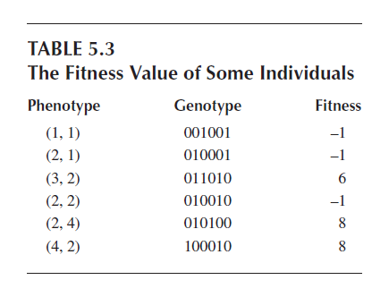
Genetic Algorithms

Slide 23
Fitness Scaling
Selection tries to select the parents that can generate good solutions in the next generation population. Selection relies heavily on the fitness values of those individuals.
The solutions with higher fitness need to be selected more often than the solutions with lower fitness values. This necessitates a fitness function to help in selection.
Scaling is a mechanism for effective selection. In scaling, the individuals in the population are rescaled according to their fitness values. The scaling of fitness values gives rise to the expected value of the individuals. This new value will then help the selection operator to select the parents.

Slide 24

Fitness Scaling
Rank Scaling
In rank scaling, the individuals in a population are ranked according to their fitness value. Each individual is given a rank from 1 to N.
The expected value of any solution in this method is given by Equation:
where ExpValue(i, t) denotes the expected value of individual i at time t; Min is the minimum most expected value, or the value for the solution with first rank; Max is the maximum most expected value, or the value for the solution with rank N; and N is the number of individuals in the population.

Slide 25

Fitness Scaling
Proportional Scaling
Proportional scaling scales the individuals directly on the values of the fitness function. The expected value is directly proportional to the individual’s fitness. This may be represented by Equation :
where a is any constant and fit(i, t) is the fitness value.
Proportional scaling has problems when the fitness of the individuals is not in a very good range.

Slide 26
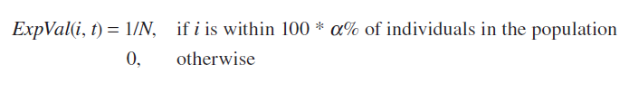
Fitness Scaling
Top Scaling
Top scaling selects a top few individuals and scales them to the same value of 1/N. All other individuals are scaled to a value of 0.
In other words, only the top specified number of individuals is considered capable of participation in selection. The rest are rejected during scaling.

Slide 27
Selection
The basic objective of selection is to pair up individuals in the population for crossover. Numerous selection techniques are available for this purpose.
Roulette Wheel Selection
In roulette wheel selection, the probability of selecting any individual is directly proportional to that individual’s expectation value. Hence the more fit solutions have a greater chance of being selected again and again. This makes the fitter solutions participate more and more in the crossover.
Each solution in the population represents a section of the roulette wheel. The higher the solution’s fitness.
For implementation purposes, the roulette wheel is implemented by first summing up all the expectations of all individuals. Let this sum be T. We then select any random number r between 0 and T.

Slide 28
Selection
Roulette Wheel (P)
T ← Sum of fitness of all solutions
r ← Any random number between 0 and T
s ← 0
for every individual p in population P
do
s ← s + fit(p)
if s ≥ r
then return p

Slide 29
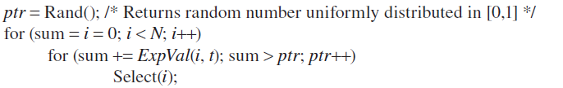
Selection
Stochastic Universal Sampling
The roulette wheel implementation faces one problem: It is likely that the high-fitness individuals will keep getting selected, and the lower ones will not get selected at all.
In this type, there are N selectors in place of one. This makes it possible to simultaneously select N individuals. The wheel is rotated only once, and the N populations are selected. This implementation is called stochastic universal sampling (SUS).
where ExpVal(i, t) denotes the expected value or the fitness function for the individual i at time t.

Slide 30
Selection
Rank Selection
Rank selection is similar to that of the roulette wheel, except that the individuals are scaled according to their ranks. The higher fitness solutions have a higher chance of being selected.
However, this method removes the dominance of a few high-fitness solutions, as might be the case with the roulette wheel.
Tournament Selection
Tournament selection further solves the problem of a solution being excessively selected and dominating the population.
In this selection, we first select any two random individuals from the population. We also select a random number r between 0 and 1. If r is found to be greater than a predefined number k (approximately 0.75), then the lesser fit individual is selected; otherwise the individual with the higher fitness is selected.

Slide 31
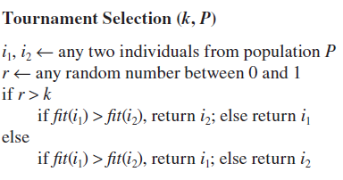
Selection
Other Selection Methods
Some of the other commonly known methods are steady state selection, remainder selection, random selection, and uniform selection.

Slide 32
Mutation
Mutation is the addition of new characteristics into the population. With mutation, we randomly try to inject newer characteristics into the population. If these characteristics are good, they will survive and continue into the next population.
Mutation is carried out on a very few individuals, because these are random characteristics that can drive the population anywhere.
The amount of mutation to be carried out is specified by the mutation rate rm, a number between 0 and 1. This number is usually kept low to keep a limited mutation in the algorithm. We iteratethrough each entity in a solution in the population.

Slide 33
Mutation
Uniform Mutation
Uniform mutation is the most common mutation operation. In this operation, the value at the selected location is simply flipped. Thus if a 0 is present in the location, it changes to 1, and vice versa.
Gaussian Mutation
Gaussian mutation happens in the case of the phenotype representation of the solution, where the solution is represented by simple numerals. In this type of mutation, we add a randomly generated number to the existing value at the selected location.
Variable Mutation Rate
The mutation rate may be changed during the running of the algorithm. This is known as a variable mutation rate. This mutation is sometimes used to control the behavior of the algorithm. A high mutation rate, as discussed earlier, is the sign of randomness, which might be a good phenomenon at the start of the algorithm.

Slide 34
Crossover
In crossover, we mix two parents to generate a new individual by taking some genes from the first parent and some from the other. The crossover operation, as discussed earlier, tries to generate fitter solutions by combining the characteristics of the parents.
One-Point Crossover
The one-point crossover is the simplest type of crossover. We select any random number between 0 and n, where n is the length of the chromosome. This point is called the crossover point.
Two-Point Crossover
Many times the one-point crossover does not give very good results. In such instances, the two-point crossover is used instead. In this crossover, we select two crossover points in place of the one that was used in one-point crossover.

Slide 35
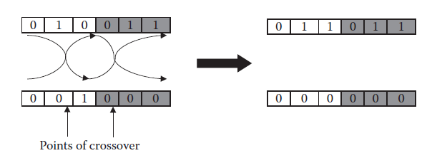
Crossover
The new solution is made by taking genes from between the two crossover points from one parent and the rest of the genes from the second parent to generate the new individual.
The two-point crossover genetic operator.
Scattered Crossover
Major problem with the two aforementioned crossover techniques is that they are position oriented, which means positioning has a great deal of relevance in deciding the crossover’s efficiency. This limits the type of individuals that can be generated.

Slide 36

Crossover
In this technique, we first create a random vector of binary values. The length of this vector is the length of the individuals. Each element of this vector is either 0 or 1, which denotes the parent.
If the vector contains 0 at any position, the gene corresponding to this position is taken from the first parent, and vice versa.
Intermediate Crossover
The intermediate crossover is usually applied over the phenotype representation. In this case, the value of any gene of the new individual is an intermediate value that is taken from the two parents. This value is calculated by Equation :
where c is the gene of the child that we need to find out, p1 and p2 are the corresponding genes of the two parents, r is any random number between 0 and 1, and a is a fixed ratio.

Slide 37
Other Genetic Operators
Eliticism
Eliticism selects some predefined proportion of individuals with highest fitness from one generation and passes it straight to the next generation. This operator saves these high-fitness individuals from being destroyed by crossover or mutation and makes them available in the next generation.
Insert and Delete
The insert operator allows the insertion of new individuals in the population pool. This makes the entire algorithm flexible to accepting new individuals. Based on the solution, at any point, we can generate new individuals with high fitness.
the delete operator allows deletion of some individuals from the population set. We may wish to delete certain individuals that have a low fitness value.

Slide 38
Other Genetic Operators
Hard and Soft Mutation
Many times the mutation operator may be split in two. One part, or the soft mutation, brings about small changes in the individual. Because the changes are small, big changes might not be expected in the behavior of these solutions.
The other operator, or the hard mutation, is used to carry out big changes in the individual. This mutation may completely transform the individual.
Repair
The repair operator may be used to repair the infeasible solutions before they are stored in the population pool. This operator converts an infeasible solution into a solution that could be feasible.

Slide 39
Algorithm Working
Any individual in a GA is represented in the form of a string of bits or numbers. This string can be seen as the building blocks of the individual, where each block contributes to some observable characteristic of the individual.
As the algorithm starts, there are random 0’s and 1’s in the population pool, which contains almost all types of solutions.
We can observe characteristics in the solutions that lie in the solution pool. Imagine there is a position i where the occurrence of 1 is very favorable and where the occurrence of 0 is unfavorable.
As the algorithm proceeds, the number of individuals with a 1 at position i keep increasing, while those with a 0 at that position keep decreasing. After a few iterations, all the individuals in the population pool will have 1 at position i. In this way, the algorithm converges.

Slide 40
Algorithm Working
We can look at the population at any time in form of schemas. A schema is the representation of the solutions in the population. The schema contains a series of 0’s, 1’s, and *’s. The length of the string is the same as the length of the chromosome in the representation of the individual.
The presence of * means that the individuals can have either 0 or 1. Hence a schema of 1**0**0* can stand for 10000000, 10100100, 11000101, and so forth.
At the start of the algorithm, the schema is very general, consisting of only *’s. It may be represented as *******. As the algorithm proceeds, the schema will have definite values for some of the prominent positions.
Now the schema will be of the form 1***0**.

Slide 41
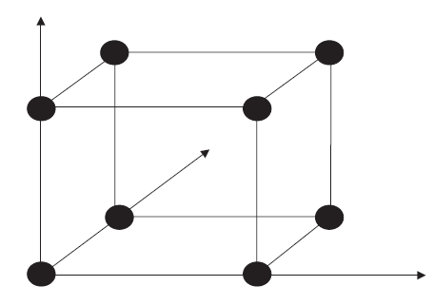
Algorithm Working
Hypercube Technique
Think of a chromosome of length n as a collection of bits. This chromosome can be represented in an n-dimensional graph, with the points lying on the extremes of the axes.
The genotype representation of search space as a hypercube.

Slide 42
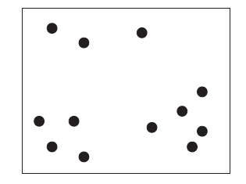
Algorithm Working
The search space for a three-dimensional graph is given in Figure where each corner of the cube denotes a valid solution of varying fitness. This denotes the whole search space of the GA. Any point searched by the GA would lie at the corner of this n-dimensional cube.
The phenotype representation of search space

Slide 43
Algorithm Working
We start with a very big search space of dimension n. As we proceed, we keep getting certain values at specific positions.
The same search space may be plotted in the phenotype form, where the number of axes is the number of numerals or variables in the solution.
Initially the individuals are randomly distributed in this search space.
As the algorithm runs and from one generation to the other, the solutions at the good places start attracting the individuals at the bad places. The attraction results in the movement, or jump, of the bad individual toward the good individual.
During the initial iteration of the algorithm, the better proportions of individuals attract all other individuals As a result, two things happen.

Slide 44
Algorithm Working
1. The entire population starts congregating to a few prominent areas in the search space.
Entire search space keeps reducing, because the individuals completely leave the areas where they were originally located to join other individuals for a search at likely locations.
As the generations continue, all individuals converge, with the search space reduced to a point.
Addition of mutation.
Mutation throws the individuals in random directions by some very small to small amounts and, in turn, expects the individuals to find good regions with high fitness values.

Slide 45
Algorithm Working
Convergence :
Convergence occurs when the fitness function value behaves almost constant, even upon further generations. The convergence depends to a good extent on the problem and the kind of effect the change in parameter brings.
For most simple problems, the convergence is relatively early. More complex problems, however, may require more generations to converge.
Along with convergence, it is important that the algorithm reaches global minima instead of stopping at some local minima. The global minima can only be explored when the algorithm generates diverse solutions.
We use Rastrigin’s function to test the convergence of GA.

Slide 46
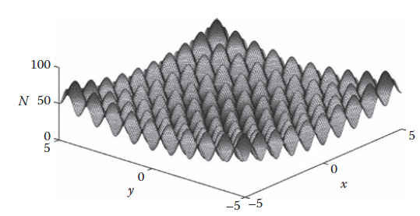
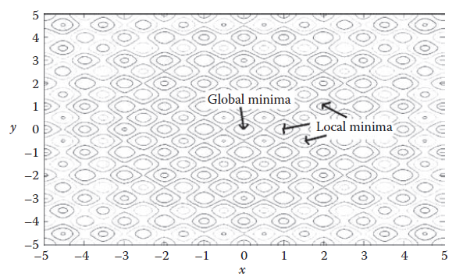
Algorithm Working
The surface of the Rastringen’s function.
The contours of the Rastringen
function, showing global
and local minima.

Slide 47
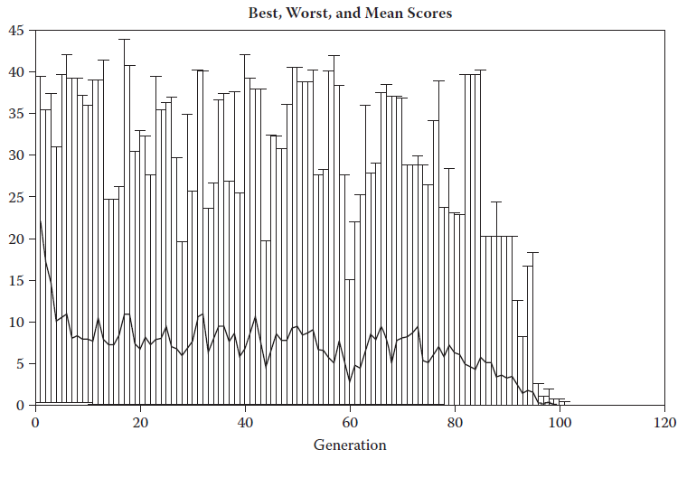
Algorithm Working
The convergence of best, worst, and mean fitness individuals in genetic algorithms.

Slide 48
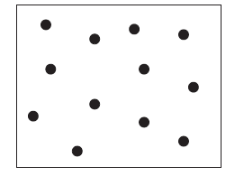
Diversity
Diversity is the average distance between the individuals in a population. This distance may be measured as the geometric, Manhattan, or any other distance between the features of the corresponding individuals in this n-dimensional map.
High distance means that the individuals are far apart in this
n-dimensional map and cover almost the entire map. With low distances, there might not be any individual at some locations.
High population diversity in search space.

Slide 49
Diversity
Diversity is of vital importance to the GA. High diversity means a large search space for the algorithm to find the global minima.
Initially all the solutions are fairly far apart, and hence the diversity is high. As the algorithm runs, the individuals start moving in search of the minima.
As the algorithm runs, more and more solutions would start concentrating near the minima. As time goes on, more and more individuals would start concentrating around the global minima.
Although it helps in convergence, it is usually not good that individuals completely vanish from some regions of the graph.
The region from which all individuals have vanished may actually contain the global minima.
The absence of individuals from some regions of the graph means the deletion of certain features. These features are deleted when they result in undesirable fitness.

Slide 50
Diversity
Grammatical Evolution
ANN or fuzzy system, where we cannot fix the length of the chromosome.
GE is an effective means for applying GA in a situation where the chromosome length varies.
In GE, the chromosome is always represented in terms of a long sequence of integers. This representation can be mapped to the needed phenotype representation by the use of simple rules.
It enables us to carry out all GA operations on this long sequence of integers, because the length is now fixed. These integers then need to be converted back into the phenotype representation for evaluation of the fitness function.
GE uses the notion of Backus-Naur form (BNF) to represent the language. BNF carries all the information of the language syntax in the form of various rules.

Slide 51
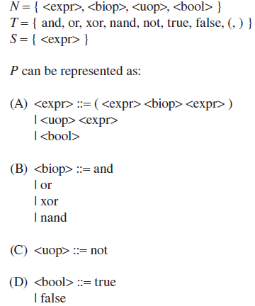
Diversity
The grammar may thus be represented by {N, T, P, S}, where N is a set of nonterminals, T is a set of terminals, P is a set of production rules, and S is the start symbol.

Slide 52
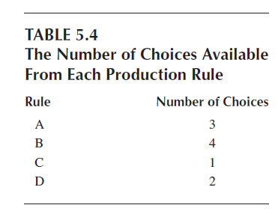
Diversity

Slide 53
Other Optimization Techniques
Particle Swarm Optimization
PSO is a technique inspired by the natural process of flocking birds, which is also known as swarm intelligence. It derives intelligence by studying the social or group behavior of the animals.
As the individuals moved in GA to find the global minima, so too do the individuals move in PSO in search for minima. In GA , however, the movement was on the basis of mutation and crossover operators.
In PSO, we follow a more mathematical, systematic approach to find the solution. The movement of individuals in PSO is guided by a set of equations.
Each individual or particle in PSO has a particular speed at which it is moving. Furthermore each particle knows the position in which it presently lies.

Slide 54

Other Optimization Techniques
In addition, all the particles know the particle that is closest to the goal (or that has the minimum fitness value). All the particles would hence try to move toward this particle in order to lower their distance from the goal, or minima.
The movement of the particles updates both their speeds and the positions. Particle movement is governed by the local and global planner. In PSO, this is modeled by a set of equations. Let the speed of any particle i at any iteration t be vi t. Let the particle be at position xi
t at this iteration. At the next iteration t + 1, the position and the speed of the particles get updated as given by Equations :

Slide 55
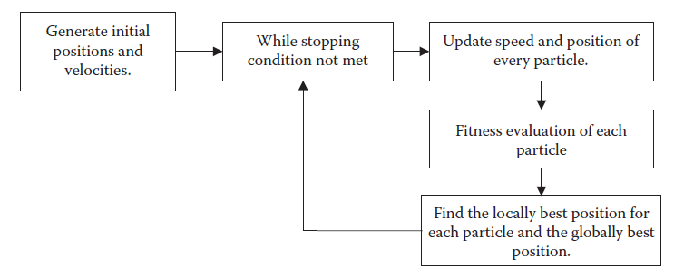
Other Optimization Techniques
where c1 and c2 are constants that are usually both fixed as 1, r is any random number between 0 and 1, xbi t is the best solution in the path of particle i until iteration t, and xg t is the globally best solution until iteration t.
The particle swarm optimization algorithm

Slide 56
Other Optimization Techniques
Ant Colony Optimizations
The other optimization studied here is the ant colony optimization (ACO). Like the PSO and GA, this algorithm is also inspired by the natural process—in this case, the process of ants working in their colonies. This process is simulated in the ACO algorithm.
The ants in this algorithm are expected to move about the search space. In their motion, the ants, or solutions, build the partial solution to the problem to be solved. At any time, numerous moves are possible; the decision of which move is made follows a probabilistic approach. As the ant moves, it keeps building this partial solution. This is the basic fundamental of the algorithm.
The move of any ant is guided by two factors—trails and attractiveness

Slide 57
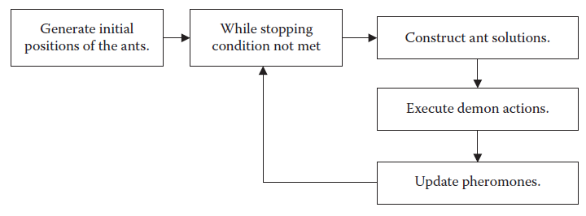
Other Optimization Techniques
The ants move in the graph according to the probability decided by the trails and the attractiveness. As the ant moves, it keeps building the partial solution.
Once all the ants have completed their tour, the pheromone on the edges is updated. First we decrease the pheromone by a small percentage to avoid excess pheromone being deposited at some edge over time. Then the edges receive pheromones depending on the quality of the solutions.

Slide 58
Metaheuristic Search
More Metaheuristic Techniques :
k-nearest neighbor approach, simulated annealing search, taboo search, hill climbing, and so on.
The k-nearest neighbor is another search algorithm that starts from some location in the graph and tries to reach the goal.
At any node n, there is a set of nodes that we can traverse from the current node. These nodes are called the neighbourhood of n, and they have an edge connecting to n. The edges have different weights, which denote the cost of traveling from the current node to the next node.

Slide 59

Metaheuristic Search
Simulated Annealing (SA)
It derives its analogy from the way in which metals are cooled and frozen into a minimum energy crystalline structure. This analogy is used to prevent the algorithm from getting trapped into some local minima. This algorithm makes some small changes to the current node n in order to arrive at some other node.
The probability of the move being executed, in case it leads to a solution with an undesirable fitness, is given by Equation :

Slide 60
Traveling Salesman Problem
Problem Description
A salesman has been given the task of selling products. He must sell to a total of n houses.
The starting house is given. The salesman must then return to the starting house at the end.
The salesman must travel in such a way that the total length of the path traversed is minimal.
This problem is known to be an NP-hard problem, which cannot be solved in polynomial time.
Let each house i have coordinates (xi, yi).
We need to find the sequence of houses that the salesman must traverse so that the entire path length is the shortest.
Let the starting house be s. The salesman must travel to all n houses. Let the order in which he travels be <s, a1, a2, a3, a4, . . . , an–1
s>. For this problem, we represent any solution by < a1, a2, a3, a4, . . . , an–1>. The actual path traced by the salesman would be s → a1 → a2 → a3 → a4 . . . an–1 → s.

Slide 61
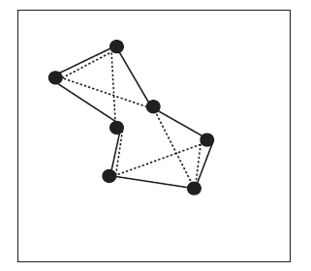
Traveling Salesman Problem
The various paths in the traveling salesman problem (TSP).

Slide 62
Traveling Salesman Problem
Cross over
We modify the crossover operation to suit this problem. Let there be 5 houses that the salesman must visit. Let us assume that the crossover operation is to be applied to two individuals <1, 4, 3, 2, 5> and <2, 5, 3, 1, 4>.
Single-point crossover is to be applied across position 3.
the solutions generated by a conventional crossover operator would be <1, 4, 3, 1, 4> and <2, 5, 3, 2, 5>.
Mutation
As discussed above, for any problem, the total path traced by the salesman is s → a1 → a2 → a3 → a4 . . . an–1 → s. The fitness function for this problem is the sum of the geometric distance between all sets of points.

Slide 63
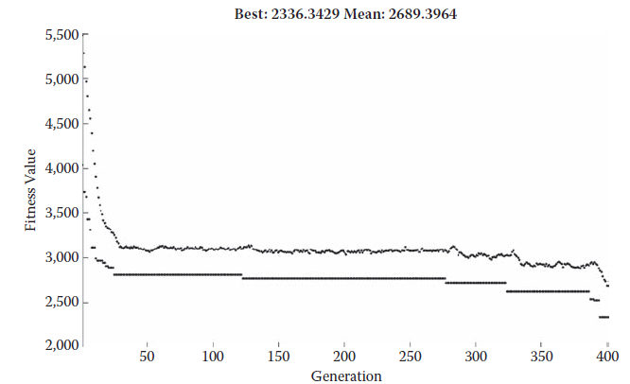
Traveling Salesman Problem
The mean and minimum fitness during optimization of the genetic algorithm for TSP.

Slide 64
Traveling Salesman Problem
Results
We took a map of the size 500 x 500 and generated 20 random initial points to act as cities. An additional point was generated to act as the starting point, which has a fixed value of (250, 250).
The double-vector method of population representation was used. The total number of individuals in the population was 1,000.
The program was executed for 400 generations. The final path length received was 2,336 units.
The path is highly optimal. We also received the final output in a finite amount of time, proving that the algorithm easily solved the problem.

Slide 65
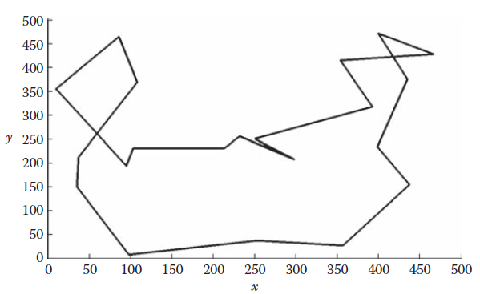
Traveling Salesman Problem
The result of TSP by genetic algorithm.

